Slide 1
Gas pump Usability Test
Blake Parmeter, Morgan Coleman, Jordan Patrou, John L. Singleton

Slide 2
Why Test the Usability of Gas Pumps?
Americans travel over 5.4 trillion passenger miles per year.
The gas pump a very commonly used interface.
Improving the efficiency of fuel delivery systems is of the utmost importance to the economy.

Slide 3
Description of Experiment
To perform a usability test on a modern gasoline pump
To expose issues with usability
To suggest methods to improve

Slide 4
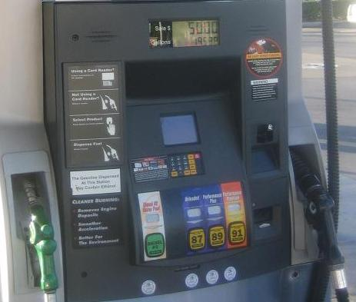
The pump used in the experiment

Slide 5
Test Subject Demographics
Our test subjects were chosen using random sampling of our peers
between the ages of 20 and 25
83% Male
83% Daily drivers
100% said they never had issues using gas pumps

Slide 6
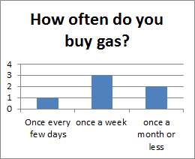
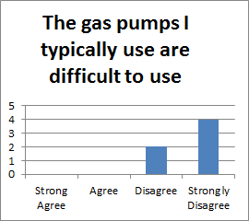
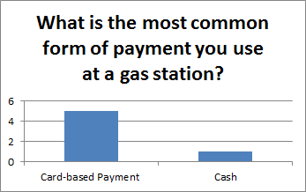
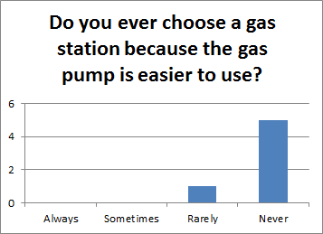
Data about the test subjects

Slide 7
Testing Methods
Users were told to purchase $4 worth of gas
Users needed to change the fuel grade in the middle of their transaction
Their reactions were recorded using video

Slide 8
Sample video of testing procedures

Slide 9
Analysis of Results
50% of the test subjects reported being confused at some point during the experiment
66% reported that the pump was frustrating to use
0% reported that the interface responded quickly

Slide 10
Analysis of Results cont’d
66% reported that they would NOT return to use this pump.
50% disagreed that new users would find the interface easy to use.
83% understood the on screen instructions
83% stated the display was easy to read

Slide 11
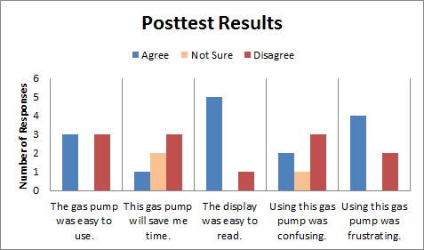
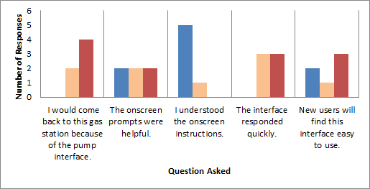
Posttest Results

Slide 12
Conclusions
The instructions were clear and easy to read
The test subjects became frustrated while using the pump
The users didn’t like the interface because there was too much delay between when button was pressed and when a confirmation was given

Slide 13
Recommendations For Improvement
Give user feedback faster
Loading messages to show the system is working
The pump subsystem does not need to be improved
The layout and the interface don't need improvement, only the speed at which feedback is displayed needs improvement

